Slide 1

Free
Chemical Process Simulator Toolkit
using Scipy
Priyank Tiwari
M. Chem 2nd year
Institute Of
Chemical Technology, Mumbai

Slide 2
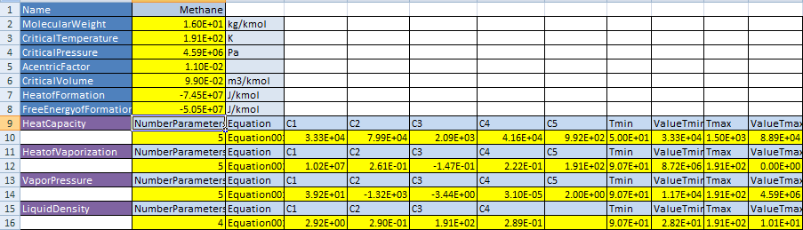
Input
Database: Perry Chemical Engineering Handbook 7th Edition
Sample input data sheet
import IdealGas
ig=IdealGas.IdealGas(Name)

Slide 3
Fit Equation of State Parameters
Cubic Equation Of State
Equation of States
Van Der Waals Equation of State ;‘vdw’
Ping Robinson Equation of State; ‘pr’
Redlich-Kwong Equation of State; ‘rk’
Soave-Redlich-Kwong Equation of State; ‘srk’
Peng-Robinson-Stryjek-Vera Equation of State; 'prsv2'
Schwartzentruber & Renon Equation of State; ‘scrk’
‘scrkdual’ & ‘srkdual’

Slide 4
Get Saturation Pressure
GRg=GRl
P
Psat
V

Slide 5
def func(P, T, gR, getCompressibilityFactors):
ZG, ZL = getCompressibilityFactors(T, P)
if ZG == ZL:
return P
else:
gRG = gR(T, P, ZG)
gRL = gR(T, P, ZL)
return gRG – gRL
Psat = scipy.optimize.brentq(func, Pmin, Pmax,
args=(T, self.gR, self.getCompressibilityFactors))
import CubicEquationOfState
eos = CubicEquationOfState.CubicEquationOfState(Name,TypeEOS)

Slide 6
Non Random Two Liquid : NRTL
import NRTL
acm = NRTL.NRTL(dict_molfraction.keys())
GE,Gamma = acm.getgamma(T,dict_molfraction)

Slide 7
Thank You

